Slide 1
Lecture 13:
Reactions of alkenes:
Carbocations’ stabilities
Regioselectivity of hydrohalogenation
Rearrangement of carbocations

Slide 2
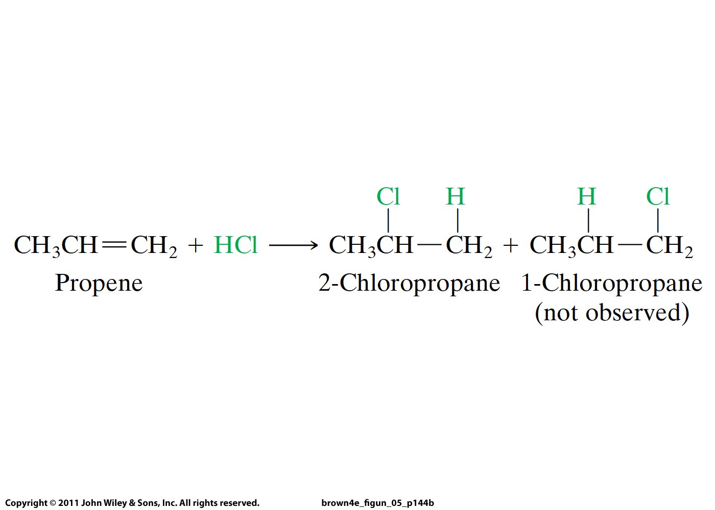
Why is this reaction regioselective?

Slide 3
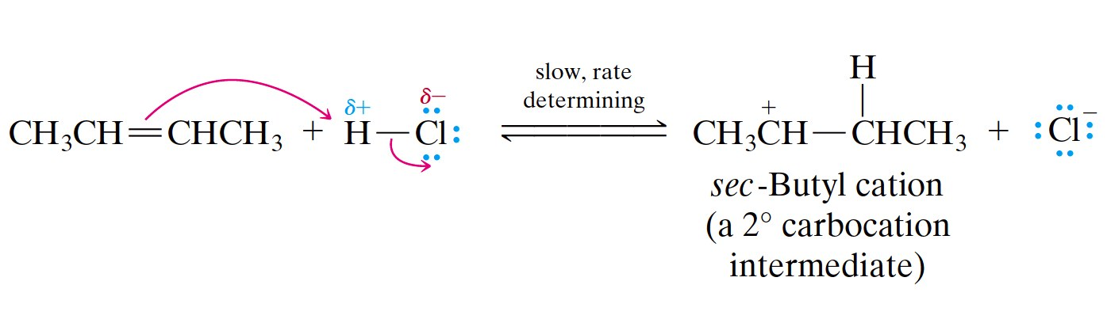
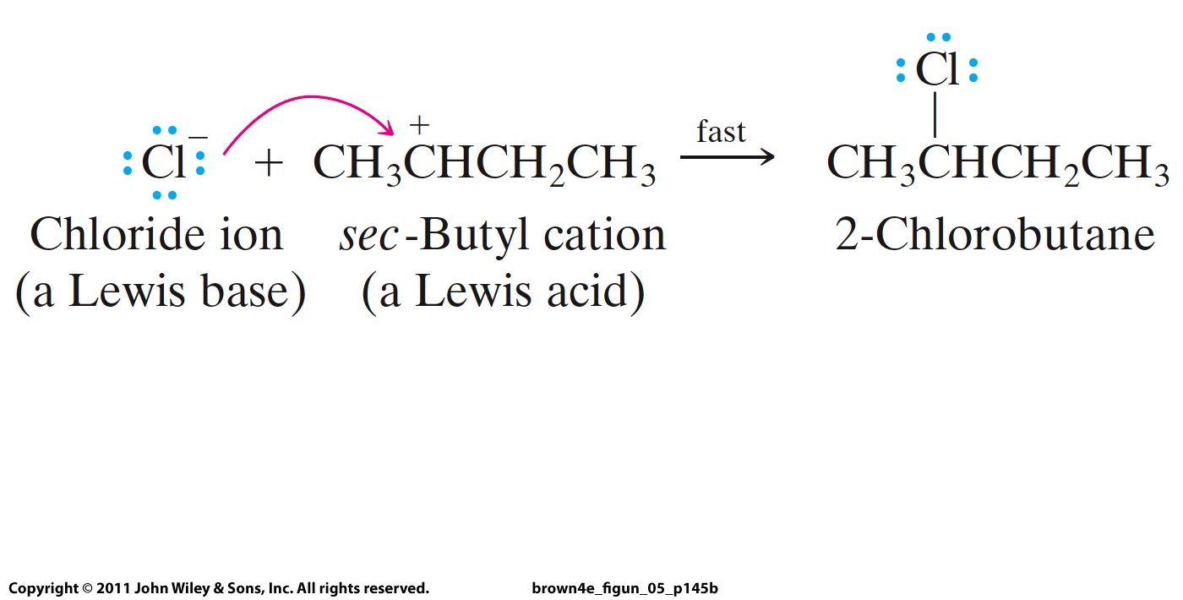
nucleophile
electrophile

Slide 4
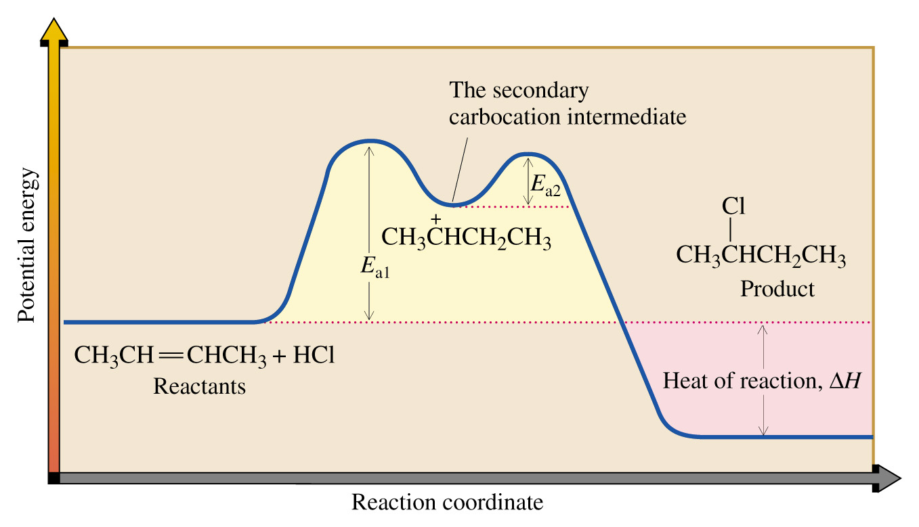

Slide 5
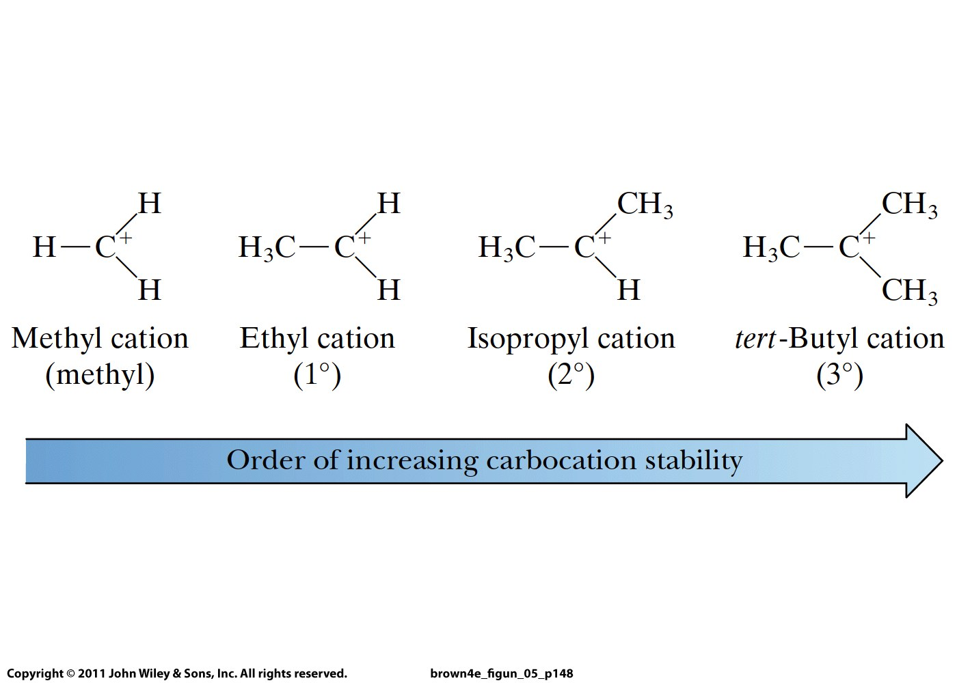

Slide 6
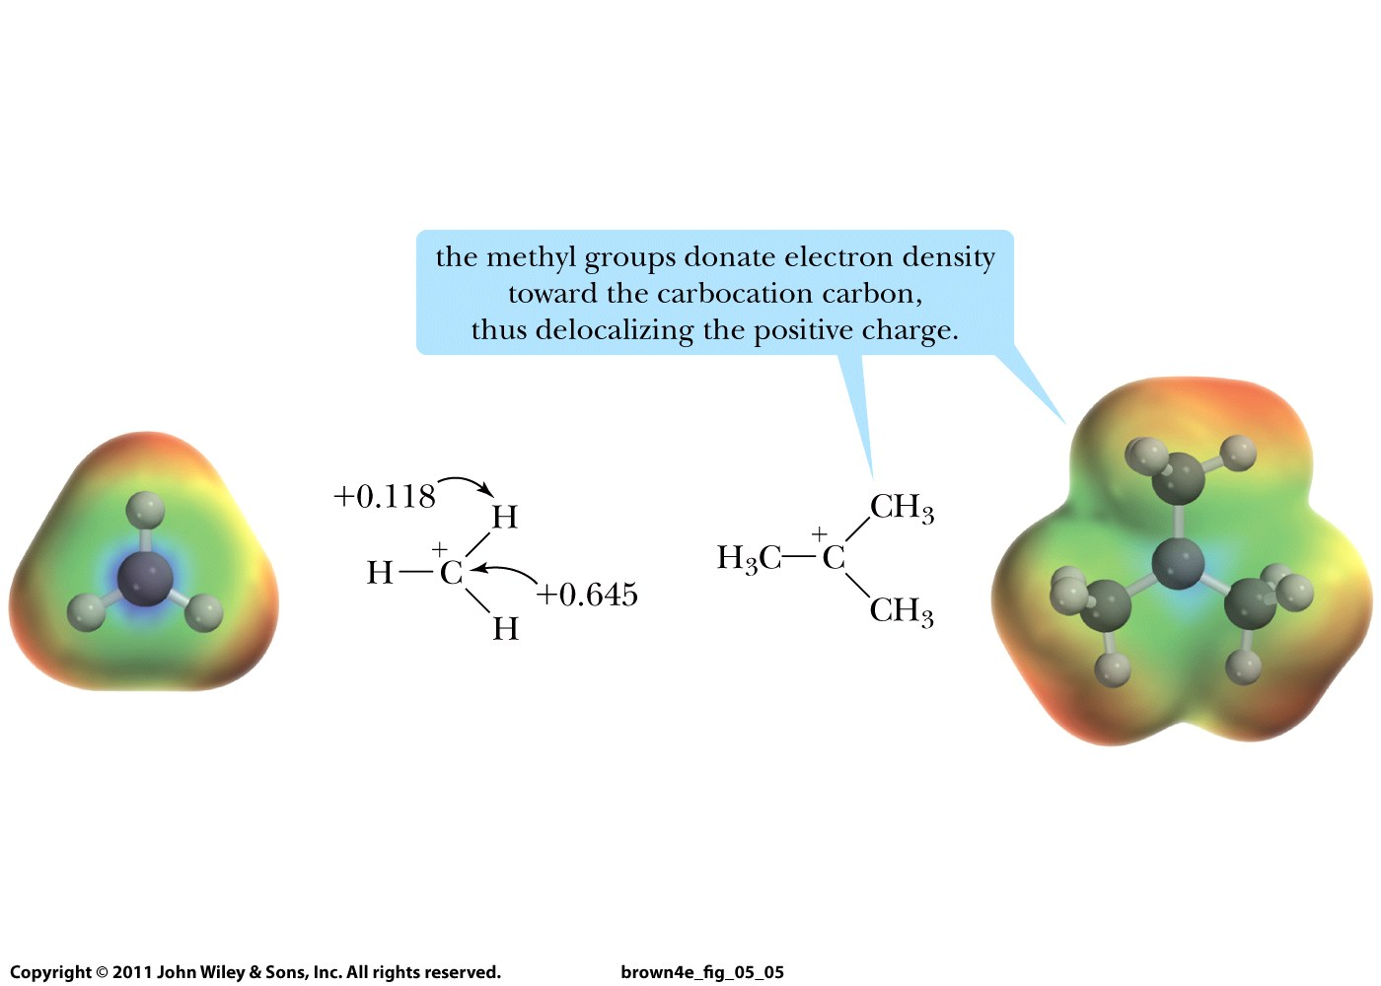
Inductive Effect:

Slide 7
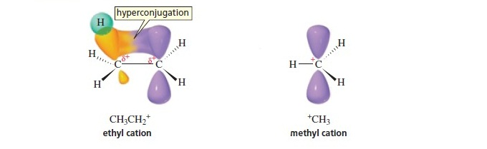
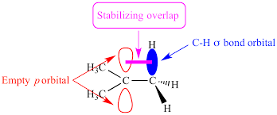

Slide 8
